Slide 1
CUSTOMER SEGMENTATION
Segmented customers by demographics and purchasing behavior to enhance targeting and develop effective marketing strategies. Applied segmentation techniques and created visualizations to uncover key insights, boosting engagement and satisfaction through tailored marketing efforts. Optimized resource allocation, leading to increased customer acquisition and retention.

Slide 2
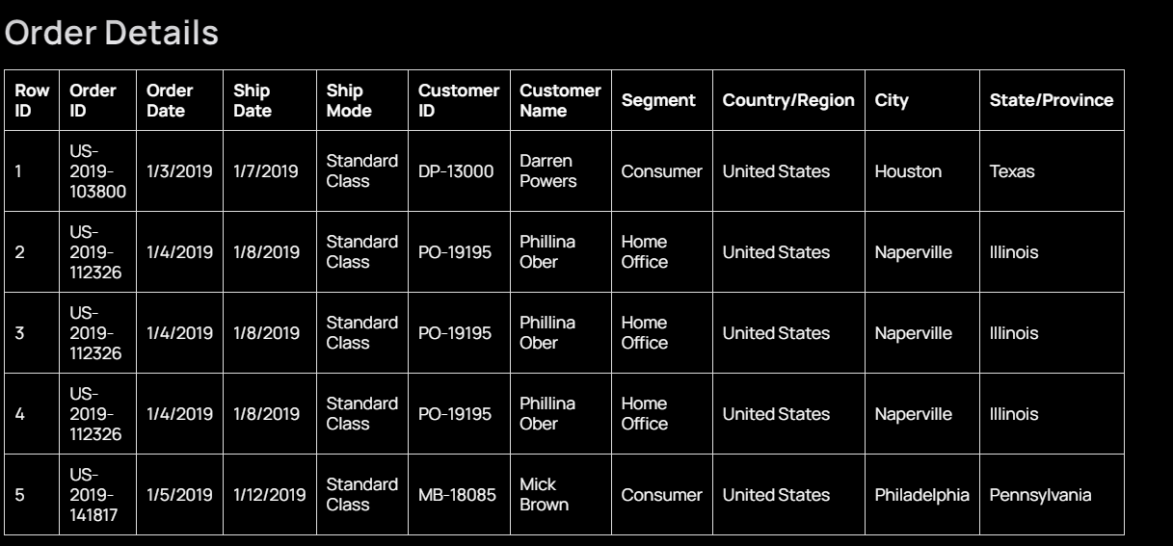
About Dataset
Segmented customers by demographics and purchasing behavior to enhance targeting and develop effective marketing strategies. Applied segmentation techniques and created visualizations to uncover key insights, boosting engagement and satisfaction through tailored marketing efforts. Optimized resource allocation, leading to increased customer acquisition and retention.

Slide 3
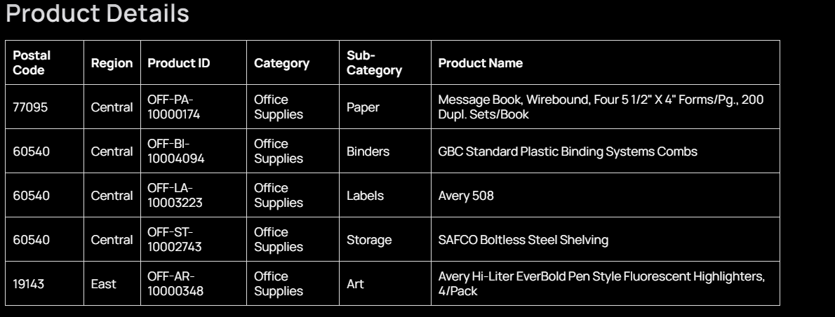
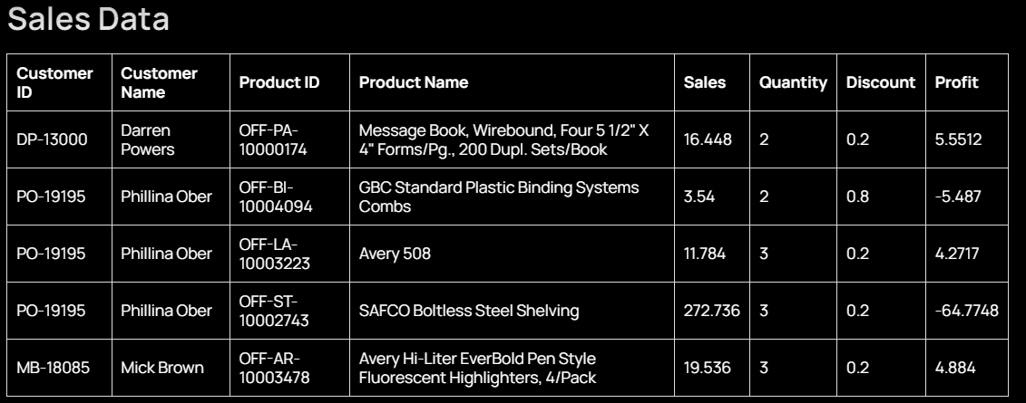

Slide 4
Challenges:
Ensuring data quality and consistency across multiple sources.
Handling sensitive information while adhering to data privacy regulations.
Managing multiple projects with tight deadlines.
Balancing competing demands and priorities.
Delivering results quickly while maintaining accuracy.
Responsibilities:
Dive deep into company data to uncover insights driving strategic decisions.
Collaborate with teams to understand needs and objectives.
Use advanced analytical tools to extract valuable information.
Translate data into actionable recommendations.

Slide 5
Objective
The objective of the business analyst within a superstore context is to utilize data analysis techniques to drive strategic decision-making and enhance operational efficiency. By interpreting business data, the analyst aims to identify opportunities for growth, improve processes, and optimize resource allocation.
Goals
Strategic Decision-Making: The primary goal is to provide actionable insights to support strategic decision-making processes. This includes analyzing market trends, customer behavior, and competitive intelligence to identify growth opportunities and mitigate risks.
Operational Efficiency: Another goal is to improve operational efficiency by identifying bottlenecks, streamlining processes, and optimizing resource allocation. This involves analyzing workflows, identifying areas for improvement, and implementing solutions to enhance productivity.
Customer Satisfaction: The analyst aims to enhance customer satisfaction by understanding customer needs and preferences through data analysis. This includes segmenting customers based on demographics, purchase history, and feedback to tailor marketing strategies and improve the overall customer experience.

Slide 6
Key Performance Indicators (KPI’s)
The heartbeat of any analysis lies in KPI’s and their Metrics. It's crucial to identify the KPIs that matter most to achieving the defined objectives and by focusing on the most relevant metrics, organizations can gain actionable insights into their customer segmentation analysis.
Total Sales
Sales by Region
Top Performing States and Cities
Top Performing Categories by Region
Top Product by Sales and Profit

Slide 7
Total Sales
SELECT SUM(Sales) AS Total_Sales
FROM orders;
Sales by Region
SELECT Region, SUM(Sales) AS Sales_By_Region
FROM orders
GROUP BY Region
ORDER BY Sales_By_Region DESC;
Top Performing States and Cities
SELECT State, City, SUM(Sales) AS Sales_By_City
FROM orders
GROUP BY State, City
ORDER BY Sales_By_City DESC
LIMIT 10; -- Adjust the limit as needed to find the top N cities

Slide 8
Top Performing Categories by Region
SELECT Region, Category, SUM(Sales) AS Sales_By_Category
FROM orders
GROUP BY Region, Category
ORDER BY Region, Sales_By_Category DESC;
Top Product by Sales and Profit
WITH ProductSalesProfit AS (
SELECT Product_Name,
SUM(Sales) AS Total_Sales,
SUM(Profit) AS Total_Profit
FROM orders
GROUP BY Product_Name
)
SELECT Product_Name, Total_Sales, Total_Profit
FROM ProductSalesProfit
ORDER BY Total_Sales DESC, Total_Profit DESC
LIMIT 1; -- This will give the product with the highest sales and profit

Slide 9
QUESTIONS

Slide 10
Average Sales and Profit per Customer
Metric: Sales per customer, profit per customer
Question: Show me the average sales per customer and the average profit per customer.
SELECT
AVG(Sales) AS Average_Sales_Per_Customer,
AVG(Profit) AS Average_Profit_Per_Customer
FROM (
SELECT Customer_ID, SUM(Sales) AS Sales, SUM(Profit) AS Profit
FROM orders
GROUP BY Customer_ID
) AS CustomerSalesProfit;
Observation: Sales per customer is $1.9k and profit per customer is $361.2.

Slide 11
Sales and Profit per Customer by Region and Category
Metric: Sales per customer, profit per customer
Question: How do sales and profit per customer vary across different regions and categories?
Sales per customer and profit per customer by region?
Sales per customer and profit per customer by category?
a. By Region:
SELECT
Region,
AVG(Sales) AS Average_Sales_Per_Customer,
AVG(Profit) AS Average_Profit_Per_Customer
FROM (
SELECT Region, Customer_ID, SUM(Sales) AS Sales, SUM(Profit) AS Profit
FROM orders
GROUP BY Region, Customer_ID
) AS RegionCustomerSalesProfit
GROUP BY Region
ORDER BY Average_Sales_Per_Customer DESC;

Slide 12
b. By Category
SELECT
Category,
AVG(Sales) AS Average_Sales_Per_Customer,
AVG(Profit) AS Average_Profit_Per_Customer
FROM (
SELECT Category, Customer_ID, SUM(Sales) AS Sales, SUM(Profit) AS Profit
FROM orders
GROUP BY Category, Customer_ID
) AS CategoryCustomerSalesProfit
GROUP BY Category
ORDER BY Average_Sales_Per_Customer DESC;
Observations:
West and East lead the chart for both sales and profit per customer, while South and Central lag behind.
Customers are spending high on Technology and Office Supplies, but furniture products are performing poorly.

Slide 13
Top Customers by Total Sales and Profit
Metric: Total sales, total profit
Question: Who are our top customers in terms of total sales and profit?
a. Show me the customer ID with total sales and profit.
b. Show me the top 100 customer IDs by total sales and total profit by region.
a. Customer ID with total sales and profit
SELECT
Customer_ID,
SUM(Sales) AS Total_Sales,
SUM(Profit) AS Total_Profit
FROM orders
GROUP BY Customer_ID
ORDER BY Total_Sales DESC, Total_Profit DESC;

Slide 14
b. Top 100 customers by region
SELECT
Region, Customer_ID,
SUM(Sales) AS Total_Sales,
SUM(Profit) AS Total_Profit
FROM orders
GROUP BY Region, Customer_ID
ORDER BY Total_Sales DESC, Total_Profit DESC
LIMIT 100;
Observation: South and Central regions seem to have customers in the lower quadrant while comparing sales vs. profit.

Slide 15
Customers Generating Negative Profits
Metric: Total profit
Question: Who are the customers generating negative profits?*Show me the customer ID with total profit less than 0.
SELECT
Customer_ID,
SUM(Profit) AS Total_Profit
FROM orders
GROUP BY Customer_ID
HAVING SUM(Profit) < 0
ORDER BY Total_Profit ASC;
Observation: Central region had the most number of customers generating negative profits, which needs further investigation

Slide 16
Conclusion
‍The disparities in sales and profit performance across regions and product categories highlight areas for potential improvement. The strong performance in the West and East regions suggests successful sales strategies that could be replicated in the South and Central regions. The high spending on Technology and Office Supplies suggests these categories are key revenue drivers, whereas the poor performance in Furniture needs attention. The issue of negative profits, particularly in the Central region, indicates underlying problems that must be addressed to enhance profitability. Strategic focus on these insights can help in improving overall business outcomes

